Slide 1
Firewall Networks (FireNet)
ACE Solutions Architecture Team

Slide 2


Firewalling in the Cloud
Layered Security Model - Defense in depth
Intra-Spoke Traffic – Distributed
Best handled by L4 SG/NSGs (Aviatrix can do it)
Lifecycle tied with compute instances (CI/CD)
Provisioned/de-provisioned by automation
Aviatrix Distributed Cloud Firewall (DCF) in Spokes
Centralized NGFW at Transit
Distributed L4 at SG/NSG for Intra-VPC/VNet
E/W and N/S Inspection – Distributed
Handle via Aviatrix L7 Firewall
Relieves 3rd party Firewalls from processing
Reduces cost by fewer egress charges and expensive firewalls
Close to applications/workloads
NetSec
E/W and N/S Inspection – Centralized
Best handled via a 3rd Party Firewall
Aviatrix provides Service Insertion, policy, and life-cycle management of 3rd party firewalls.
Centralized security policy from the 3rd party firewall platform
1

Slide 3
Challenges of Centralized Service Insertion in the Cloud
Firewall Vendors
Cloud Provider
Customer
Firewall vendors have repackaged on-prem solutions to cloud
Not focused to solve cloud networking and challenges
Expect customer to own routing traffic to and from FWs
Solution which might lack enterprise features you need
Expect customer to figure out routing traffic to and from FWs
Manually figure out routing and troubleshooting
Many components involved that require individual config/ops (LB, NAT GWs, routes, etc.)
Lack of visibility and troubleshooting tools
Lack of visibility and troubleshooting tools reduces efficiency and increases risk

Slide 4
Firewall Architecture Options in Public Cloud
3rd party Firewalls (L4+L7)
Mature security solutions and established skillset
Inserting in traffic path is manual and error prone
NGFW based transit lacks common control plane
Route management / traffic steering is customer responsibility
Aviatrix Distributed Cloud Firewall
Built for cloud workloads
Different than On-prem Firewalls
Providing L4, L7 and Microsegmentation capabilities
Repeatable across regions and clouds
Feature Maturity
CSP provided L7 Firewalls
Lacks deep security intelligence and maturity
Lacks tooling for visibility and troubleshooting
Inserting in traffic path is manual and error prone
Instance level FWs - SG/NSG (L4 FWs)
Sprawl of SGs/NSGs
Governance, audit, and support challenges
Helps in compliance but not sufficient on its own
Aviatrix can help orchestrate
Complex
Ease of Use
Simple
Ease of Use
3
3

Slide 5
Aviatrix Transit FireNet

Slide 6






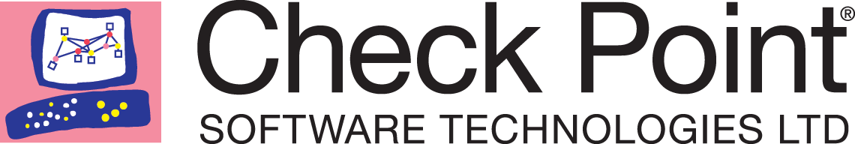
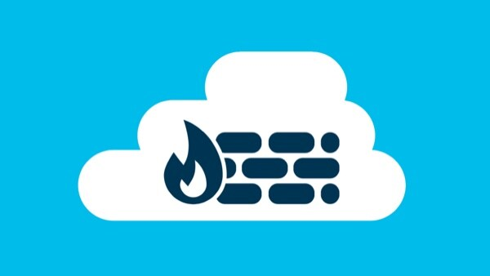

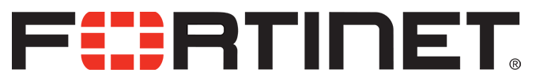
Aviatrix Firewall Network (FireNet) for 3rd Party Centralized Service Insertion
Scale out, multi-AZ FW deployments
VPC/VNET
VPC/VNET
VPC/VNET
VPC/VNET
Automated route management Segmentation and Connection Policies
Aviatrix ActiveMesh
Deep visibility and operational capabilities
Transit Firenet
Repeatable architecture, across regions and clouds
IPsec
VPN
Direct Connect/
Express Route
Bring Your Own Appliance

Slide 7
Aviatrix Firewall Network (FireNet) for 3rd Party Centralized Service Insertion
From the Aviatrix CoPilot, you enable FireNet (or through TF)
Aviatrix Controller deploys the Firewalls.
Aviatrix Controller configures the interfaces and routing entries on the firewalls.
No SNAT, IPsec, BGP, or other elements are required to insert the FWs into the traffic path.
Aviatrix Controller ensures all the Spokes and other connected networks marked for inspection have their traffic inspected by the FW.
Aviatrix Controller monitors the health of the FW instances and ensures the traffic is only forwarded to “up” Firewalls.
Aviatrix GWs or a native cloud LB incorporated into the overall design ensures the traffic is correctly load-balanced to all available FWs while maintaining the session stickiness.
VPC/VNET
VPC/VNET
VPC/VNET
VPC/VNET
Aviatrix ActiveMesh
Transit Firenet
IPsec
VPN
Direct Connect/
Express Route

Slide 8

Aviatrix FireNet Load Balancing and Failover
The Aviatrix Controller monitors the health of the Firewalls
Controller periodically checks Firewall instance health
Session stickiness is maintained
Existing sessions on working firewalls are not disturbed
AKA resilient hashing
VPC/VNET
VPC/VNET
VPC/VNET
Transit

Slide 9
Aviatrix FireNet Performance
Spoke VPC/VNet
Aviatrix ActiveMesh
Transit VPC/VNet
AZ A
x 10 Firewalls
Spoke VPC/VNet
AZ B
x 10 Firewalls
Spoke VPC/VNet
80Gbps
~75Gbps on AWS
Active/Active Firewalls
FireNet Policy to choose workload VPCs for inspection
Works across the board – no guesswork required

Slide 10
Aviatrix FireNet Failover
Spoke VPC
Aviatrix ActiveMesh
Transit VPC
AZ A
x 10 Firewalls
Spoke VPC
AZ B
x 10 Firewalls
Spoke VPC

Slide 11
Aviatrix FireNet Failover
Spoke VPC
Aviatrix ActiveMesh
Transit VPC
AZ A
x 10 Firewalls
Spoke VPC
AZ B
x 10 Firewalls
Spoke VPC

Slide 12
Aviatrix FireNet Failover
Spoke VPC
Aviatrix ActiveMesh
Transit VPC
AZ A
x 10 Firewalls
Spoke VPC
AZ B
x 10 Firewalls
Spoke VPC

Slide 13






FireNet Architecture Options (Azure Example)
Each firewall set can scale independently based on need
Dual Hub FireNet
Single Hub FireNet
RFC1918
0/0
RFC1918 and 0/0
Internet
Internet
12

Slide 14
Centralized FireNet

Slide 15
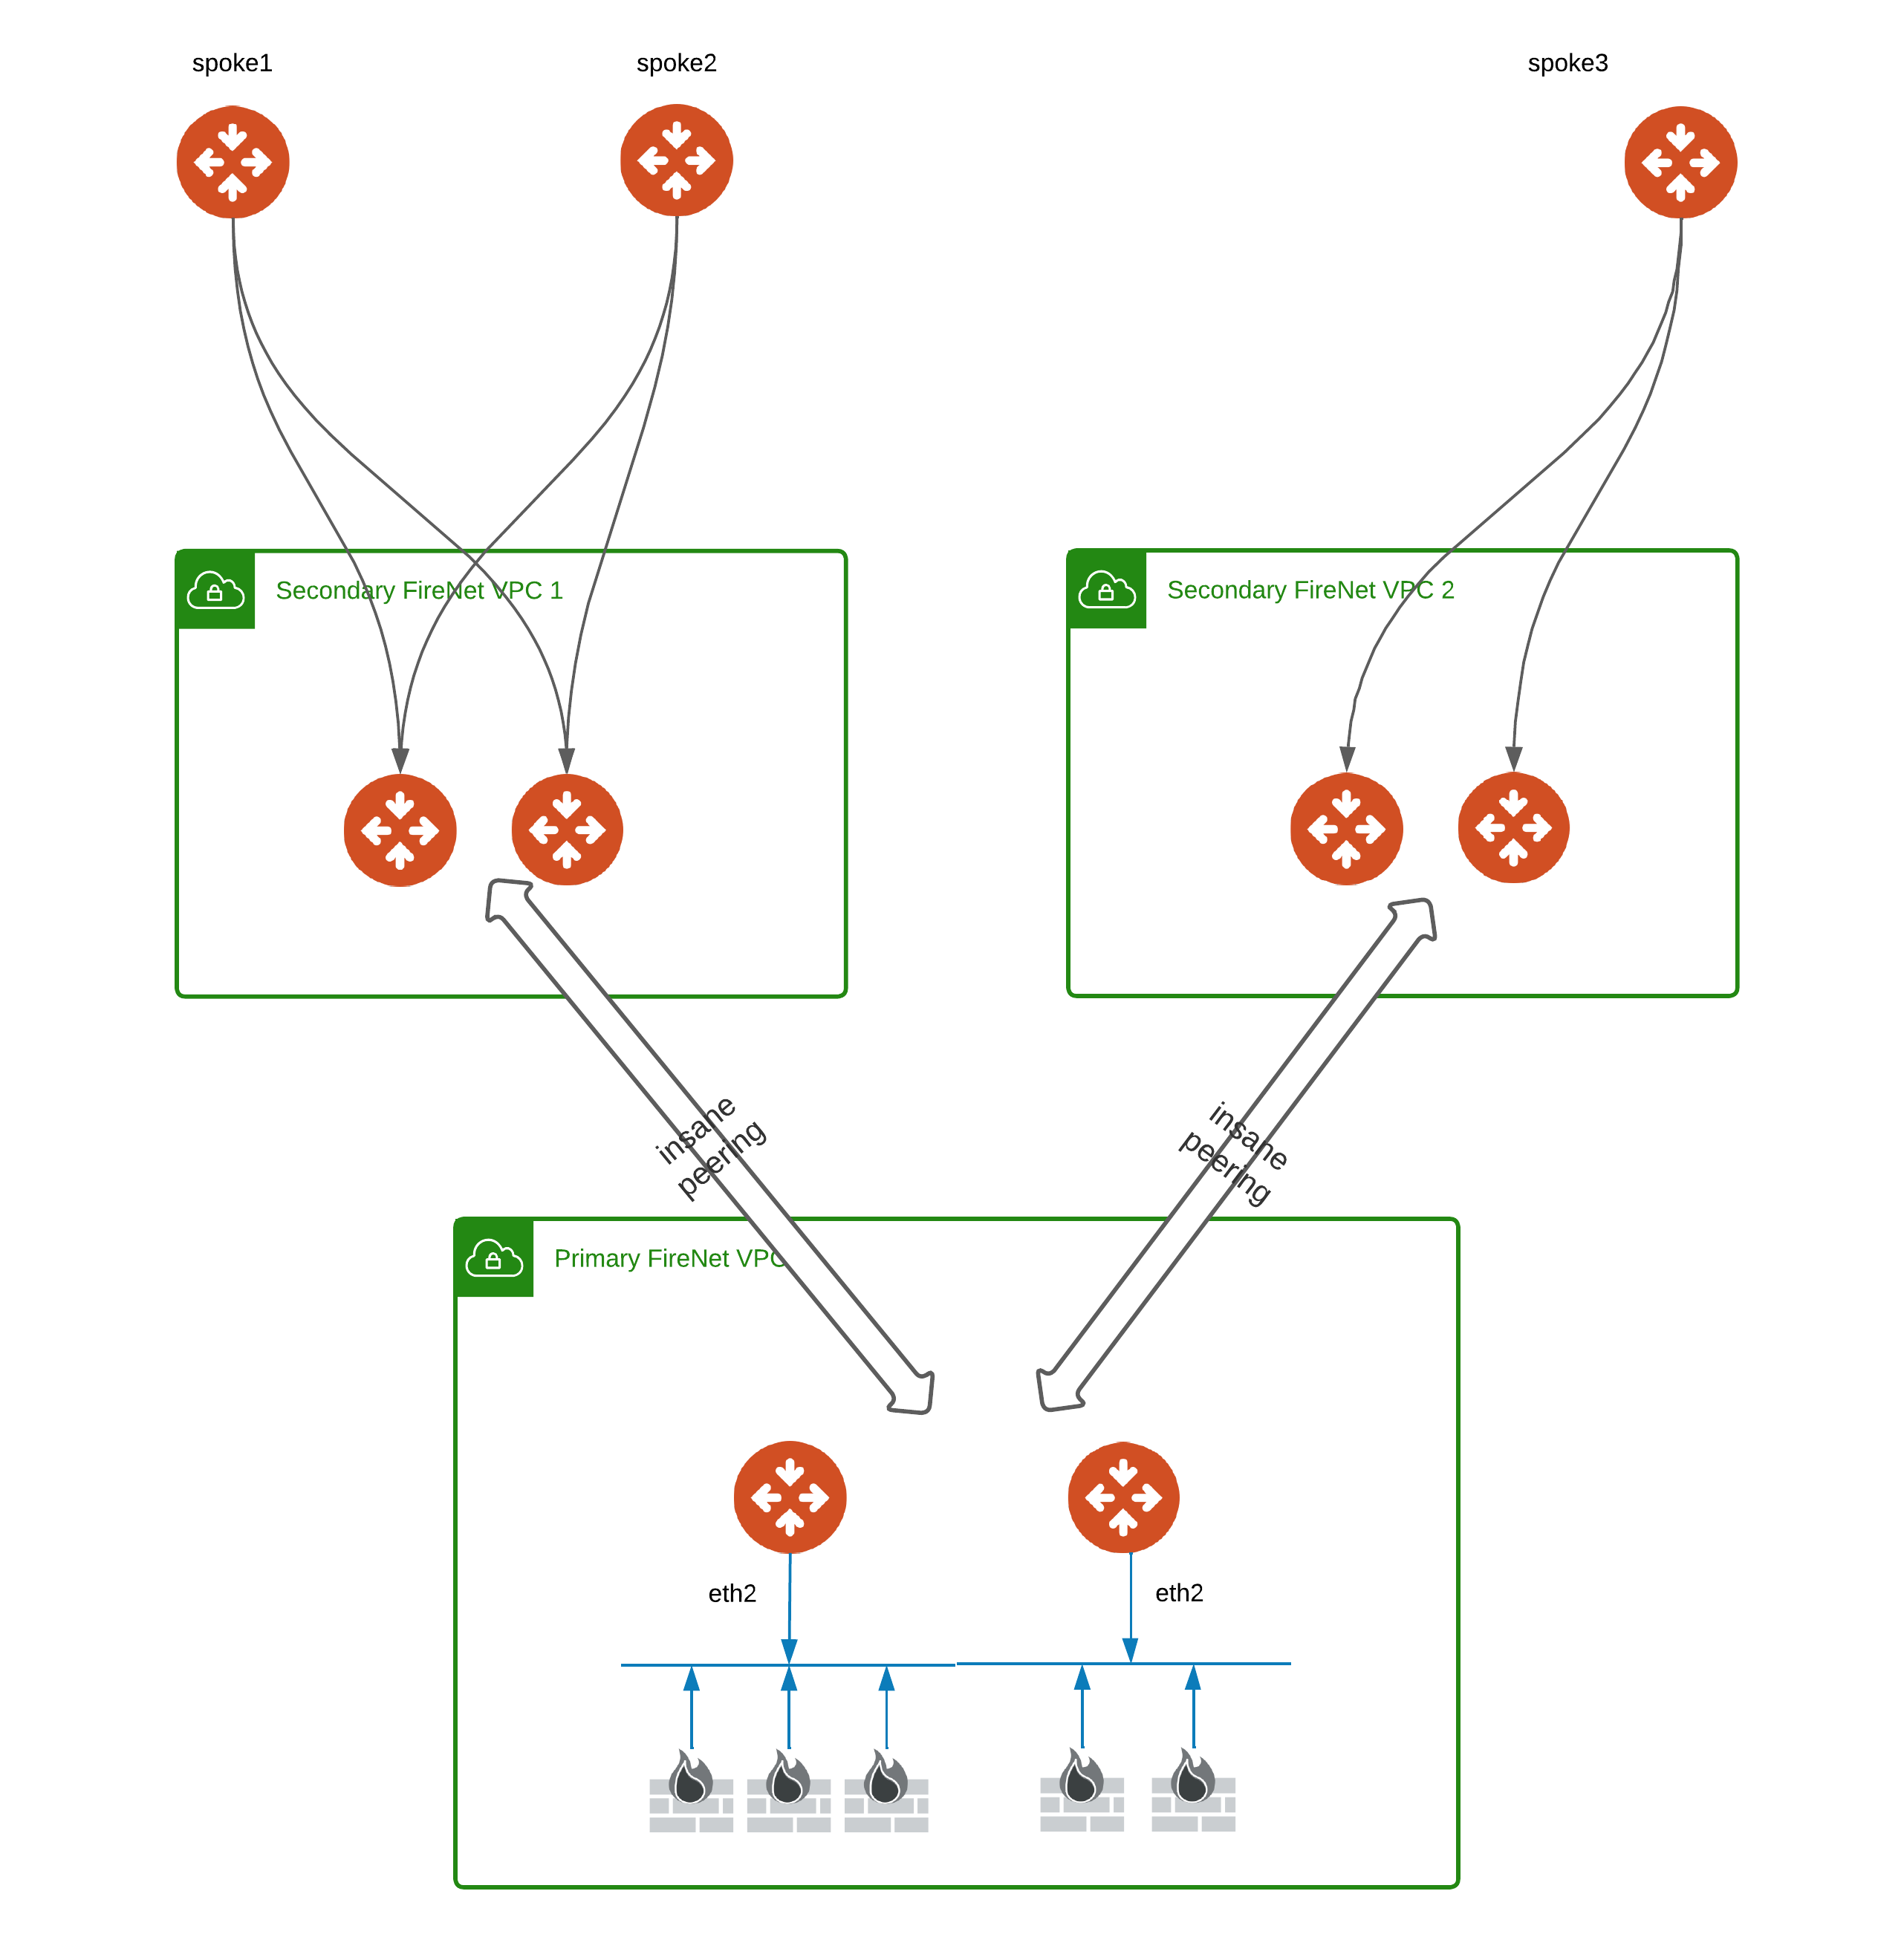
Overview
Centralized FireNet (CFN) = AWS Only + Transit FireNets + Multi-Tier Transit
2-tier MTT architecture
Spokes can be AWS or non-AWS
Terminology
SFN – Secondary FireNet
PFN – Primary FireNet

Slide 16
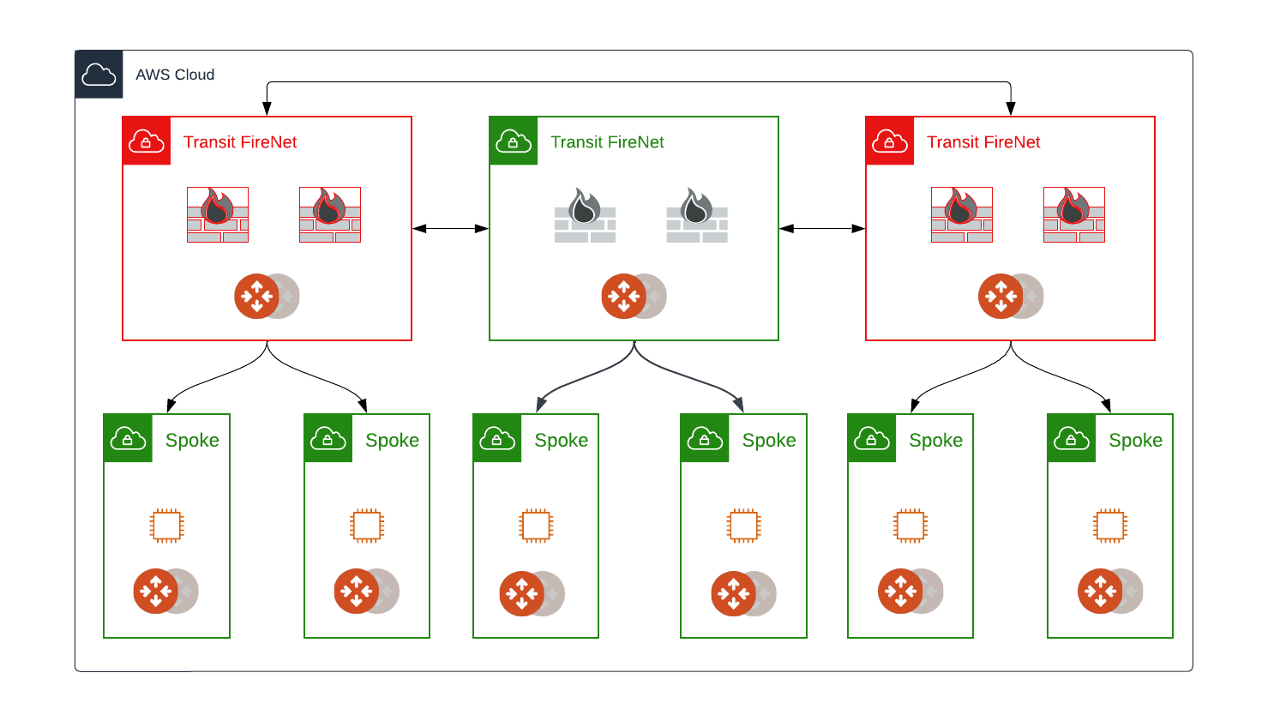
Traditional Model

Slide 17
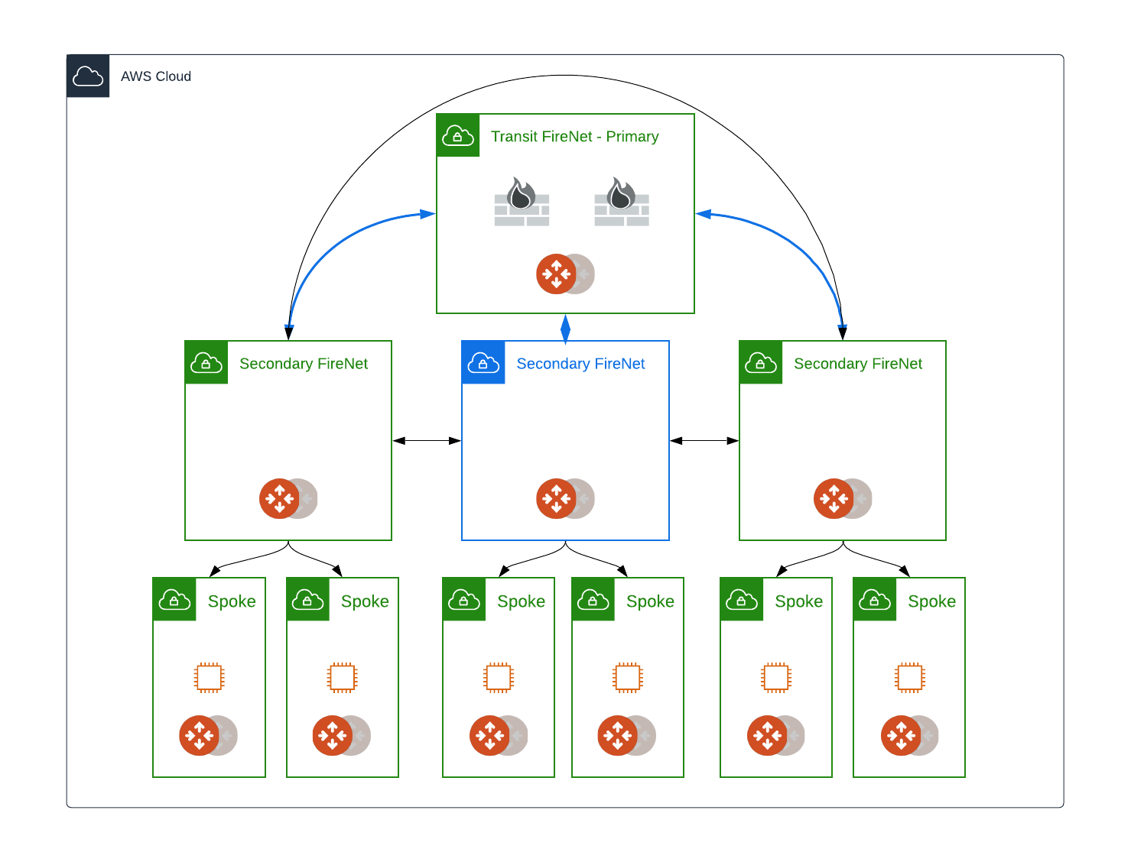
Centralized FireNet Model

Slide 18
Summary
Transit FireNet makes security service insertion MUCH MUCH EASIER!
All four major CSPs supported
Consistent insertion across CSPs
Easily direct traffic from selected Spokes to Transit FireNet for Layer 7 inspection

Slide 19
Resources
Secure Internet Ingress Design - AWS GWLB Pros and Cons
https://youtu.be/KSrt3htsGkA?feature=shared
DEPLOY - AWS Gateway Load Balancer (GWLB) with PAN (Palo Alto Network) Firewalls (NGFW)
https://youtu.be/OgeEsuBftTM?feature=shared

Slide 20
Next: Lab 7 - FireNet

Slide 21
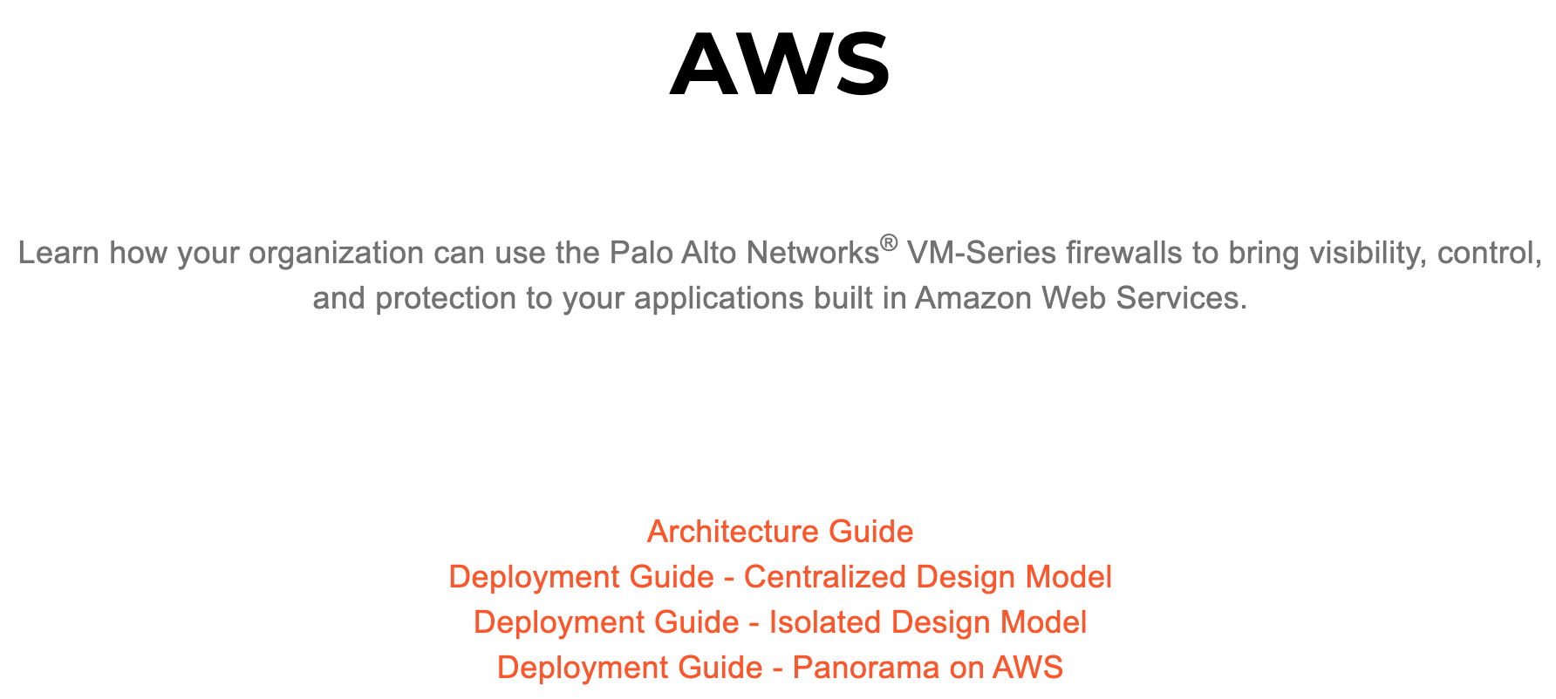
Long Reads in One Cloud…
84 page PDF!
126 page PDF!
38 page PDF!
94 page PDF!

Slide 22
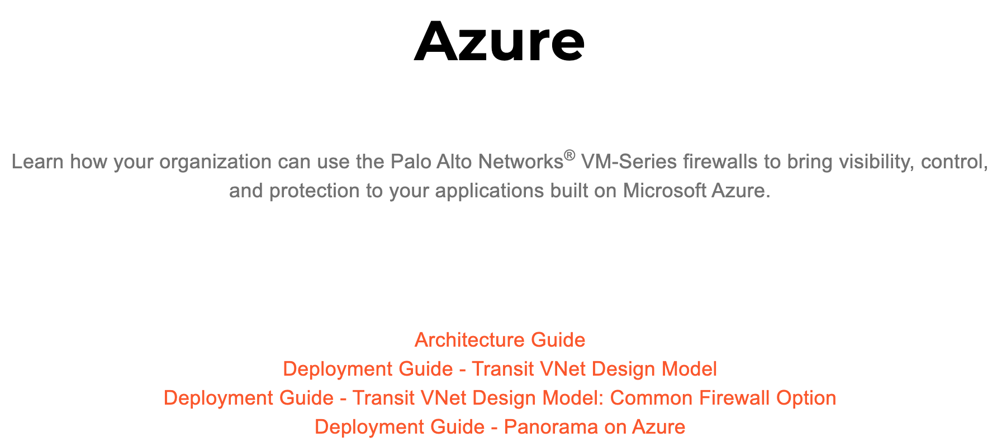
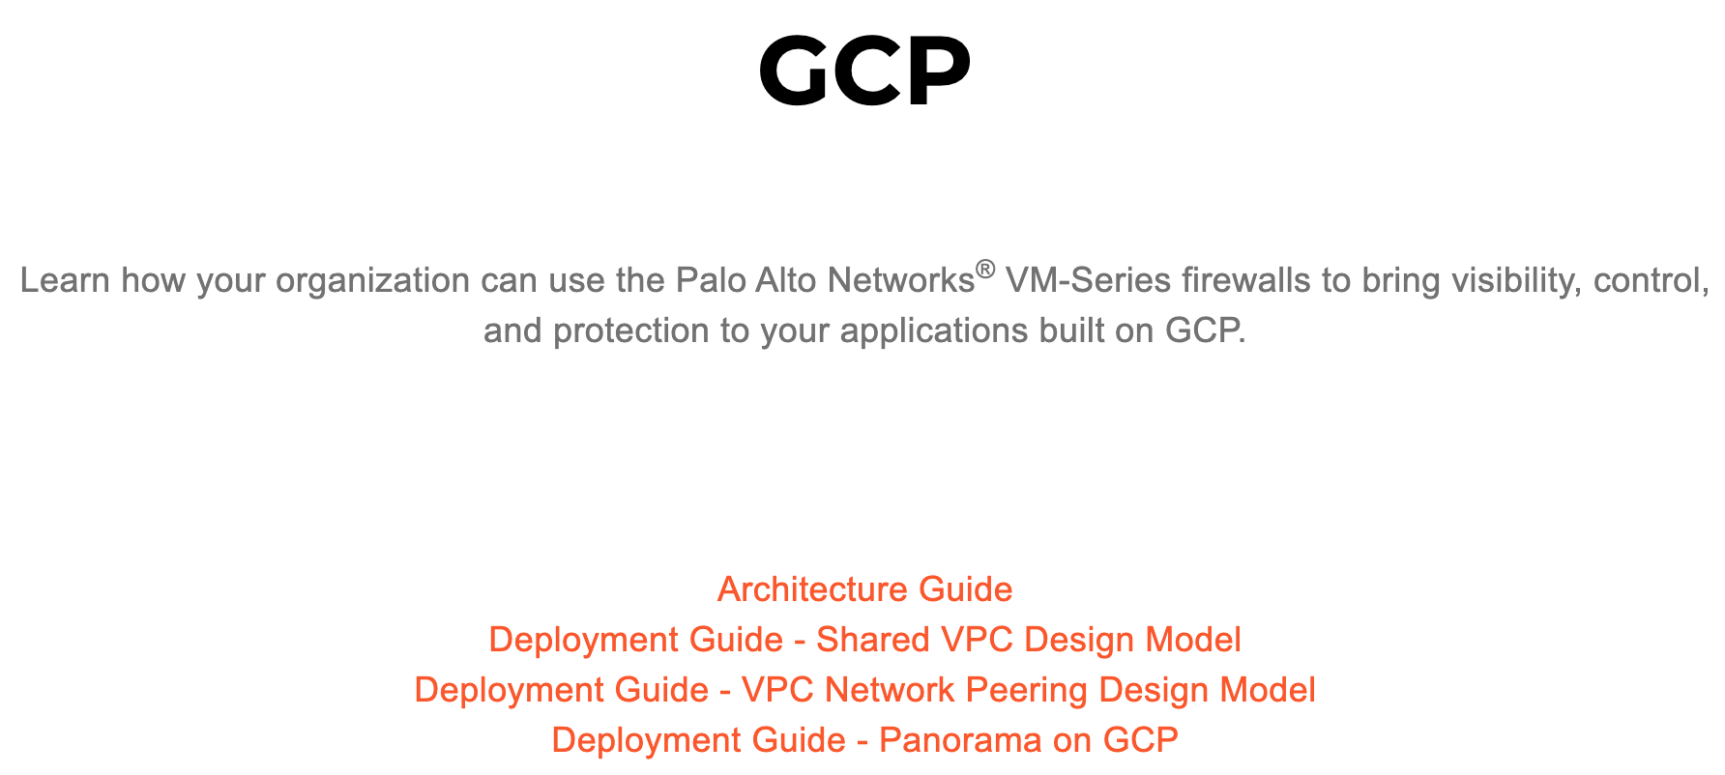
Long Reads in Other Clouds…
~500 pages of reading!
400+ pages of reading!

Slide 23






Centralized 3rd Party Firewall
Business and Technical Requirements
Consumer/PII Data
InfoSec. Mandates that specific or all traffic must go through a 3rd Party Centralized Firewall for L7 Inspection
Business Drivers: Security, Compliance, Audit, etc.
Technical Need: L7 Inspection, DPI, IDS/IPS, etc.
Existing processes and skillset on specific vendors
Compliance is achieved using a particular design and feature set
Desire to maintain compliance with limited impact

Slide 24
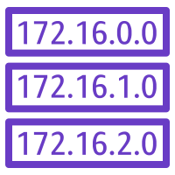


Centralized Firewall Traffic Patterns
AWS
INTERNET
GCP
AWS
VPC
VPC
VPC
VPC
Azure
VPC
Firewall Network
VNET
Inter-VPC/VNet
Ingress-Egress to/from Internet
Data Center
Partners / Sites / Branches
Inter-Region / Inter-Cloud
Partner Site
Branch
Data Center

Slide 25
Complexity of Deploying 3rd Party Firewall in the Cloud
Lot of documentation
Choose a cloud
Read Reference Architecture
Choose a Deployment Model
Read the Deployment Guide for the chosen Deployment Model
Deploy VM-Series
Rinse and Repeat …
Example: https://www.paloaltonetworks.com/resources/reference-architectures
24

Slide 26






Aviatrix Multicloud Service Insertion/Chaining
Multiple Design Patterns
Single Transit FireNet (E-W, Ingress and Egress)
Dedicated FireNets for E-W and Egress (shown)
Dedicated Ingress VPC via E-W FW (purple box)
Firewall Service Insertion
E-W / Egress / Ingress / all traffic
High Performance Encryption (HPE)
Active / Active – Across AZs
No IPsec / No BGP / No SNAT required
Automated Control and Management
Repeatable architecture across regions/clouds
Centralized firewall deployment
Vendor API integration
UDR and VPC Route propagation
Improved Failure Detection and Failover
Health Check monitoring
Forwarding Algorithm Options
Intelligent traffic steering and firewalling based on traffic type
5-tuple and 2-tuple
Firewall Bootstrap Support
Firewall zero-touch deployment capability in Azure and AWS
Aviatrix Controller
Bring Your Own Appliance
Prod VPC
Prod VPC
Dev VPC
Dev VPC
Prod VNet
Prod VNet
Ingress LB
Dev VNet
Dev VNet
Transit VPC
Transit VPC
Transit VNet
Transit VNet
FireNet
FireNet
FireNet
FireNet
East/West
Egress
Egress
East/West
High Performance Encryption
AWS - REGION
Internet
Internet
AZURE - REGION
High Performance Encryption
Direct
Connect
Express
Route
Site 2 Cloud
Site 2 Cloud
On-Prem DC
Branches
Extranet
Branches
Extranet
On-Prem DC
FireNet Terraform Demo: https://youtu.be/FFuDo8AZxmo
25

Slide 27

Isolation and Control for Departments, Apps and BUs
Encrypted Traffic
Repeatable Architecture - Single Region
VPC/VNet
VPC/VNet
VPC/VNet
VPC/VNet
VPC/VNet
VPC/VNet
VPC/VNet
VPC/VNet
VPC/VNet
VPC/VNet
VPC/VNet
Transit w/FWs
Transit w/FWs
Transit w/FWs
Transit
VPC/VNet
Transit w/o FWs
Centralized Internet
Direct Connect
Environment 3
(Isolated)
Environment 4
(No FWs)
Central IT Services
Environment 2
Environment 1

Slide 28
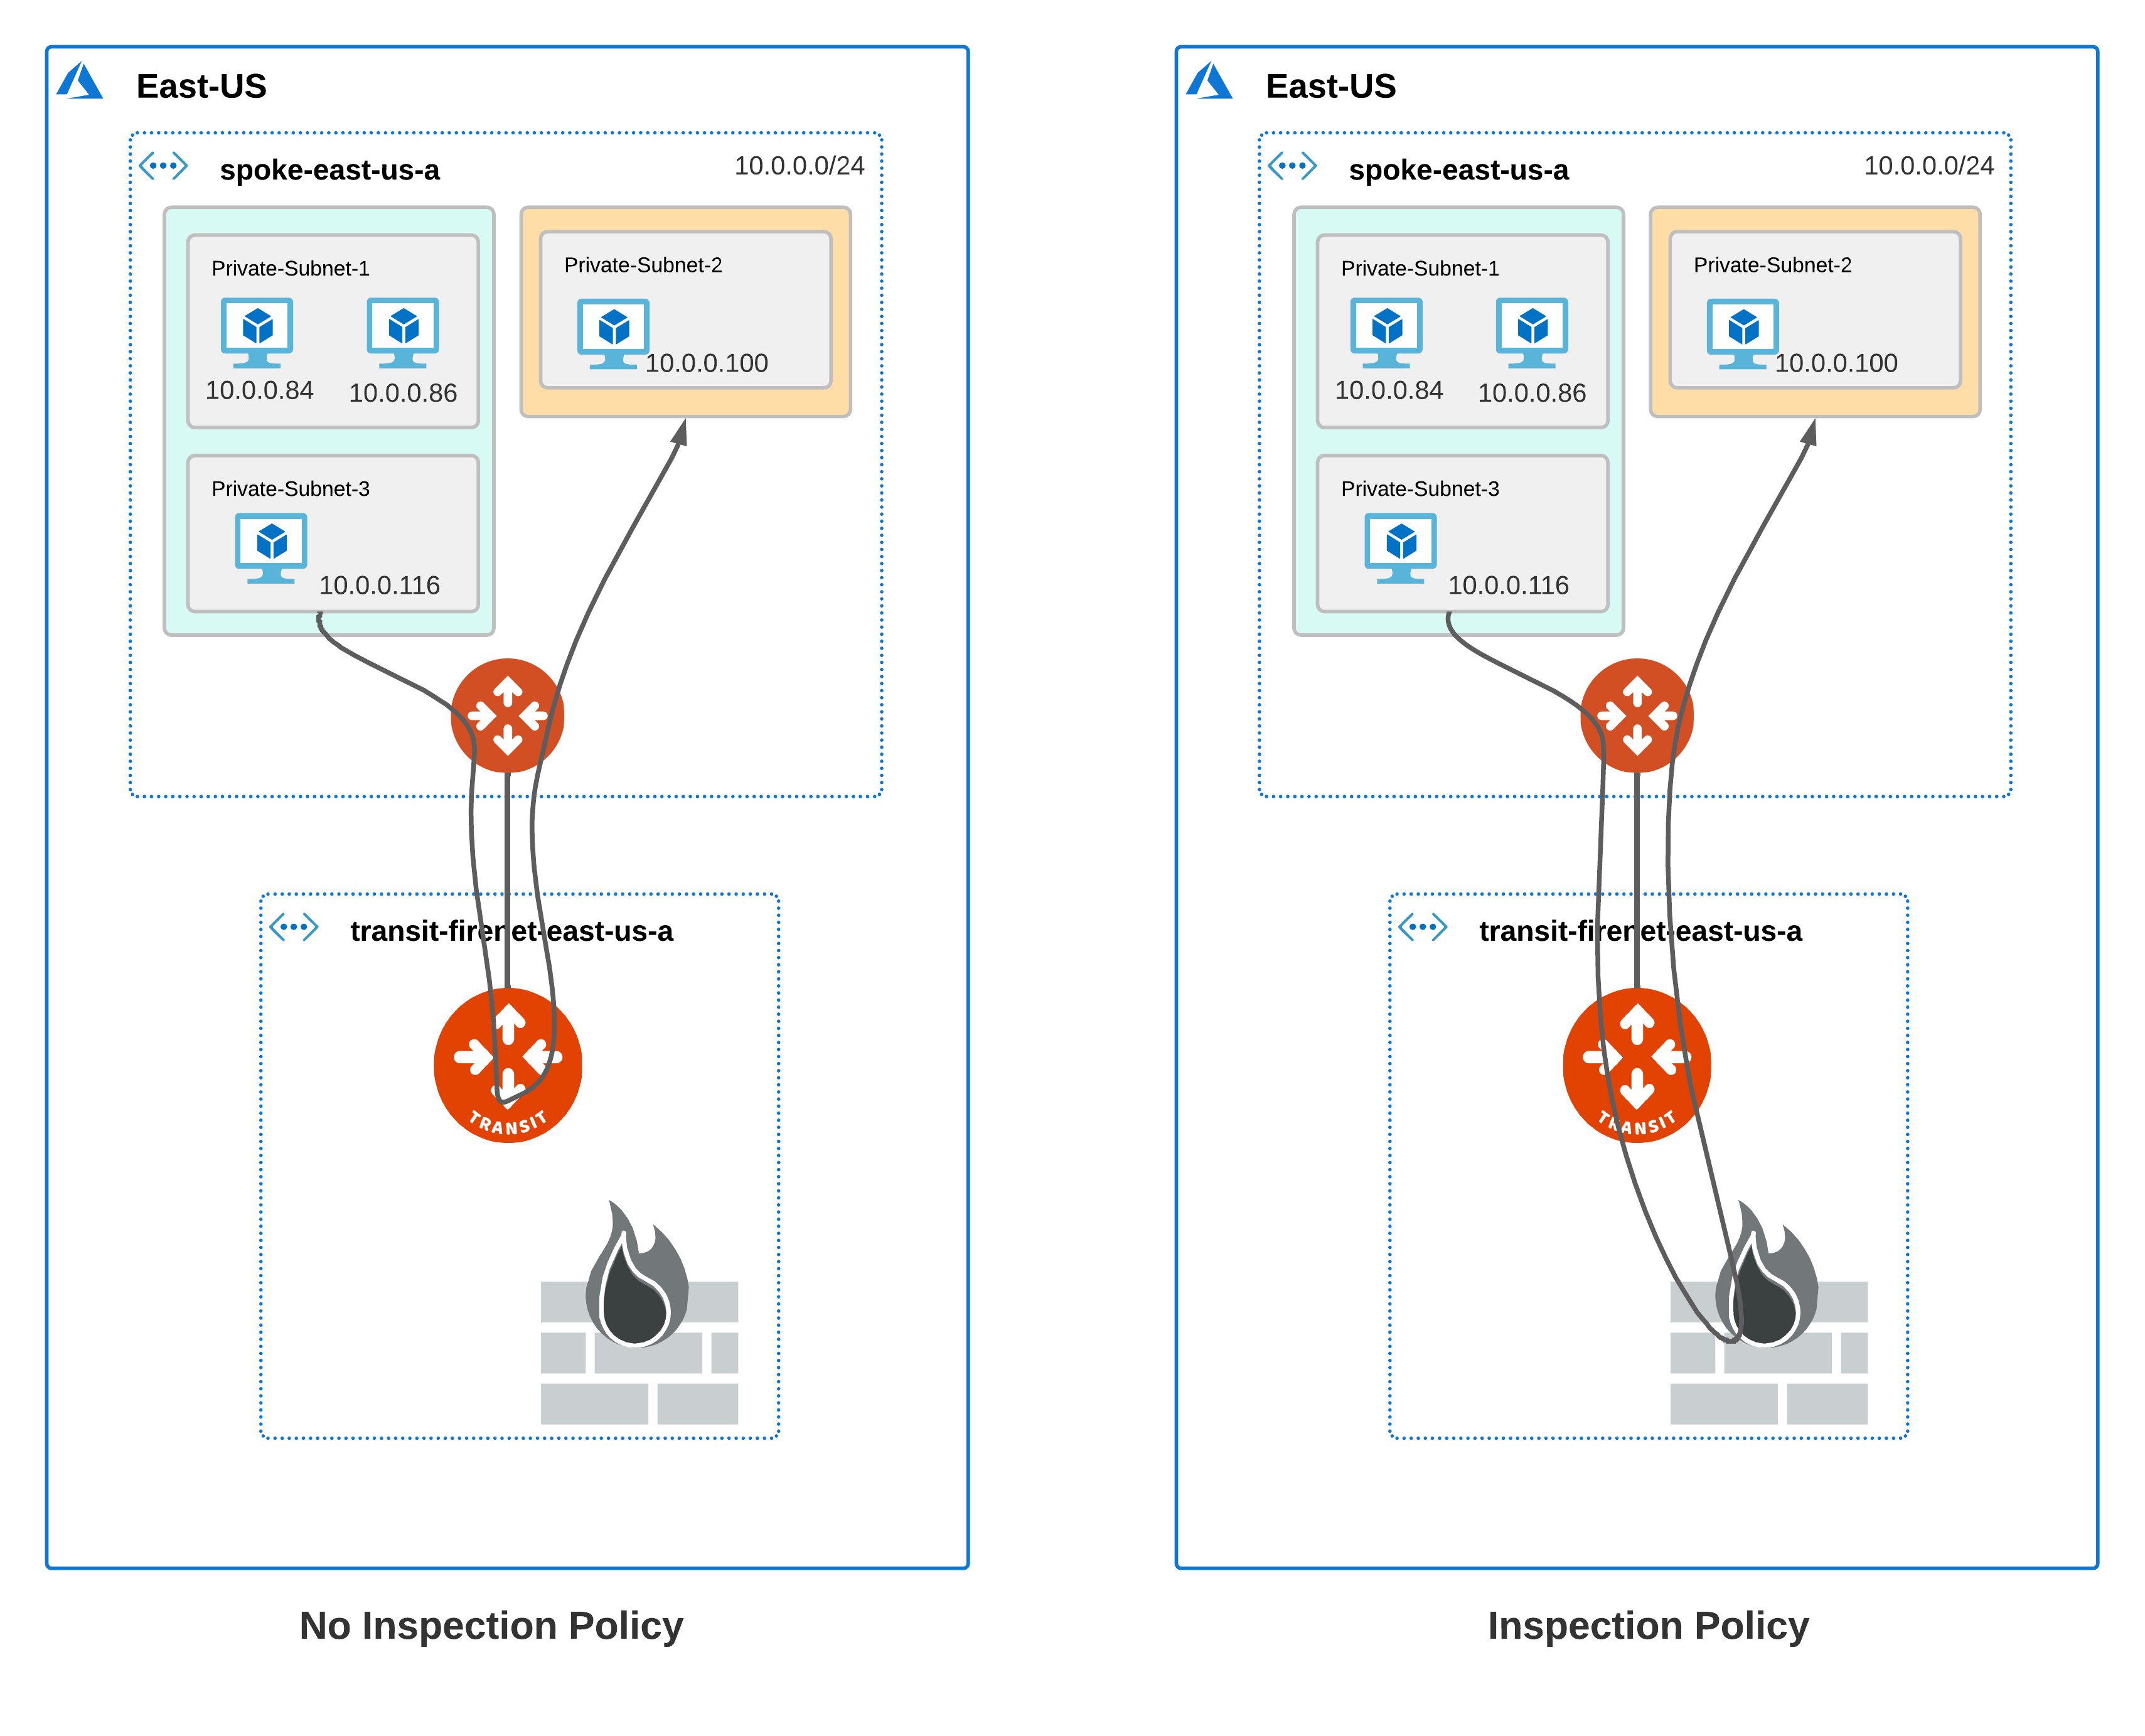
Subnet-level Inspection in Azure (released in 6.6.5404)
Subnet Groups -- Logical grouping of subnets in a VNet
Local to VNet -- unlike segmentation domains, does not span across VNets
Subnet Group name does not have to be unique across VNets
Subnet Groups may or may not have an inspection policy
If a group has inspection policy, traffic redirected to firewall, otherwise it just traverses the transit gateway
https://docs.aviatrix.com/HowTos/transit_subnet_inspection_azure.html

Slide 29
Aviatrix Transit FireNet Packet Walk

Slide 30

FireNet Packet Walkthrough – AWS Example
A Host 1.10 communicating with 2.20 with VPC A inspected via FireNet
The local route table for 1.10 has RFC1918 routes pointed to its local gateway
The local Aviatrix spoke gateway will ECMP traffic with 5-tuple hash to one of the Aviatrix Transit Gateways
The Aviatrix Transit Gateway receiving the flow will check PBR rules to determine if either source or destination requires FireNet. If a match, traffic is redirected to the one of the available FWs (it can be in the same AZ or a different AZ – when it’s in a different AZ, Transit GW sends the traffic first to the other Transit GW).
The Firewall selected will process the packet and send the traffic back to its local Transit Gateway.
The Aviatrix Transit Gateway will receive the processed packet and PBR this traffic back into the egress interface and ECMP traffic with 5-tuple hash towards the destination spokes.
The spoke gateway will receive the traffic and route the traffic out its local interface to the VPC route table. Note that this GW may not be in the same AZ as the destination instance.
The destination will receive the original traffic and see this as native VPC communication flow.
VPC A
VPC B
1
1.10
7
2.20
2
6
3
5
4
29

Slide 31
FireNet Packet Walkthrough – AWS Example
Return Flow: 1.10 communicating with 2.20 with VPC A inspected via FireNet
The local route table for 2.20 has RFC1918 routes pointed to its local spoke gateway for return traffic.
The local Aviatrix spoke gateway will ECMP traffic with 5-tuple hash to one of the Aviatrix Transit Gateways
The Aviatrix Transit Gateway receiving the traffic will pass the traffic to the the same FW which handled the initial flow to maintain symmetry (directly or via another Transit GW).
The stateful Firewall will process the return traffic and route the traffic back to its designated gateway.
The Aviatrix gateway will ECMP traffic with 5-tuple hash to one of the destination spoke gateways.
The destination spoke gateway will route this traffic out its local interface to the native VPC route table.
The original source will receive the return traffic and see this as native VPC communication flow.
VPC A
VPC B
7
1.10
1
2.20
6
2
5
3
4
30

Slide 32

FireNet Packet Walkthrough – Azure Example
A Host 1.10 communicating with 2.20 with VNET A inspected via FireNet
VNET A
VNET B
The local route table for 1.10 has RFC1918 routes pointed to its local gateway
The local Aviatrix spoke gateway will ECMP traffic with 5-tuple hash to one of the Aviatrix Transit Gateways
The Aviatrix Transit Gateway receiving the flow will check PBR rules to determine if either source or destination requires FireNet. If a match, traffic is redirected to Azure ILB.
The Azure ILB will perform a 5-tuple hash to send the traffic to one of the backend pool members.
The Firewall selected will process the packet and send the traffic back to its defined Transit Gateway.
The Aviatrix Transit Gateway will receive the processed packet and PBR this traffic back into the egress interface and ECMP traffic with 5-tuple hash towards the destination spokes.
The spoke gateway will receive the traffic and route the traffic out its local interface to the Azure VNET route table.
The destination will receive the original traffic and see this as native Azure communication flows.
1
1.10
8
2.20
2
7
6
3
4
5
31

Slide 33
FireNet Packet Walkthrough – Azure Example
Return Flow: 1.10 communicating with 2.20 with VNET A inspected via FireNet
VNET A
VNET B
The local route table for 2.20 has RFC1918 routes pointed to its local spoke gateway for return traffic.
The local Aviatrix spoke gateway will ECMP traffic with 5-tuple hash to one of the Aviatrix Transit Gateways
The Aviatrix Transit Gateway receiving the traffic will pass the traffic to the ILB. The gateway will PBR the traffic back to the ILB for FireNet.
The Azure load balancer will hash the traffic however, the reverse flow hash will match the initial flow to ensure symmetry.
The stateful Firewall will process the return traffic and route the traffic back to its designated gateway.
The Aviatrix gateway will ECMP traffic with 5-tuple hash to one of the destination spoke gateways.
The destination spoke gateway will route this traffic out its local interface to the native Azure route table.
The original source will receive the return traffic and see this as native Azure communication flows.
8
1.10
1
2.20
7
2
6
3
4
5
32

